Slide 1
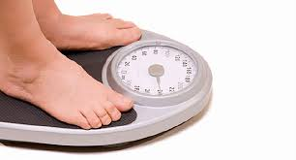
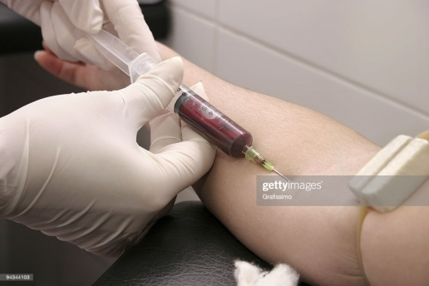
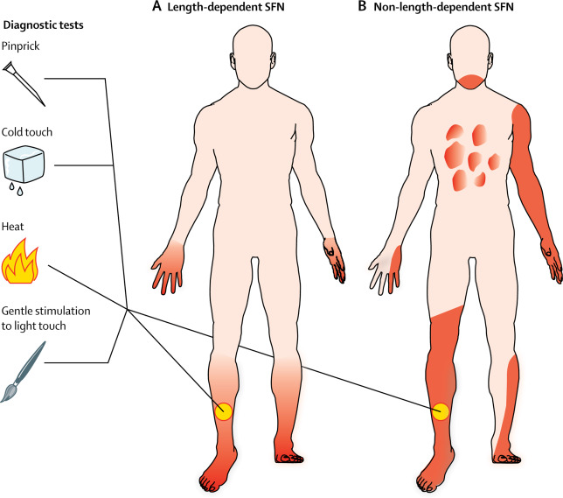
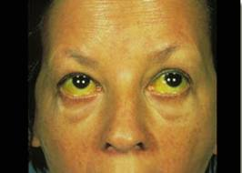
Patient monitoring for drug safety during MDR-TB treatment
LIFT-TB Community Engagement Project Training of Trainers for TBPeople Philippines
23-25 August 2021
Manila, Philippines
Mamel Quelapio. MD
Consultant, TB Alliance
In collaboration with TBPeople Philippines

Slide 2
Outline
Patient monitoring
Part 1: Monitoring treatment response
Part 2: Monitoring drug safety

Slide 3
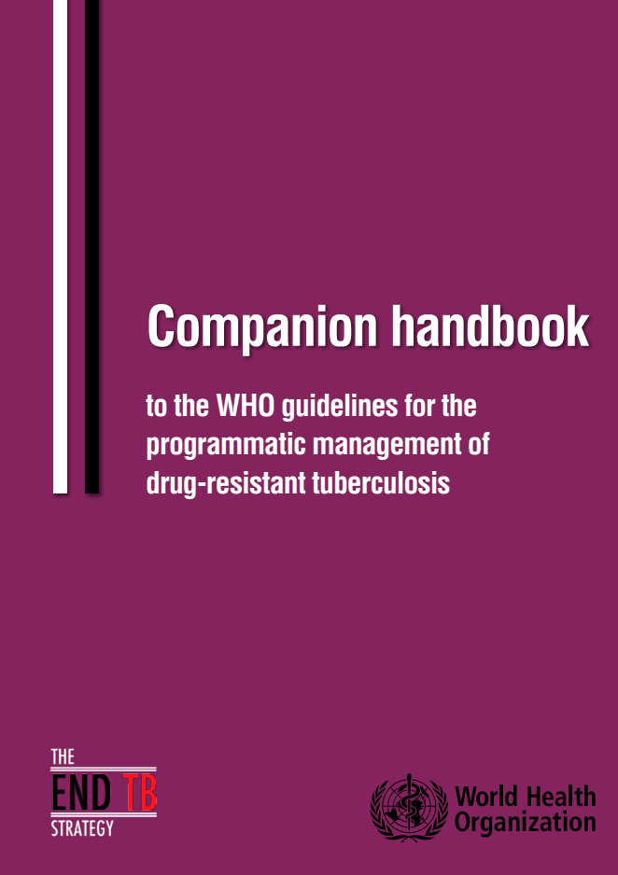
References
2015
2020
2014
2018
http://endtb.org/guide

Slide 4
Active TB drug-safety monitoring and management (aDSM)
Proactive and step-by-step assessments of PWTB who are on MDR-TB treatment through
1. Clinical assessment
2. Laboratory assessment
to detect to manage
to report
suspected or confirmed drug effects

Slide 5
Adverse event (AE)
Any unexpected or unpleasant sign or symptom or laboratory abnormality
not present at the start of treatment and now present while taking the medicine
already present at the start of the treatment and became worse
The sign or symptom may or may not necessarily be caused by the medicine itself but by other factors.

Slide 6
Adverse drug reaction (ADR)
An unexpected or unpleasant response to a medicine given at a normal dose to a PWTB which is possibly caused by the medicine.

Slide 7
Adverse events of TB and MDR-/RR-TB survivors
DS-TB survivors: | Skin Itchiness Acne breakout and darkened skin tone Numinipis and balat at mahapdi for 2 months Abdomen Acid reflux Respiratory Shortness of breath and back pain (first 2 months of treatment)
Thanks to Agnes, Miarmy, Rann, Ruzzeth

Slide 8
Adverse events of TB and MDR-/RR-TB survivors
MDR-TB survivors | Hearing Hearing impairment unreported while undergoing treatment (detected late; after treatment na napansin) Neurologic and mental health Severe depression with thoughts of suicide Memory loss like forgetting to gulp or the right way to bite; tremors on fingers and toes; partial paralysis Sobrang pagkahilo after maturukan ng injectable Metabolic Pagtaas ng uric acid na may pamamaga ng paa Hypothyroidism No menstruation for 1 year Skin Super dark, veiny, and dry skin and unable to comb hair
Thanks to Kit, Leo, Louie, Nino

Slide 9
M/XDR-TB survivors …
but with permanent disabilities
“I am free of TB but I suffer from permanent hearing loss.”
“Tuberculosis Made Me Blind, but we can make sure no one else needs to suffer like I did”
Mildred Fernando-Pancho, Philippines, XDR-TB survivor and Champion
https://www.pri.org/stories/2011-11-14/face-tb-mildred-fernando
Louie Z, Philippines, MDR-TB survivor and Champion
https://www.huffingtonpost.com/louie-zepedateng/
tuberculosis-made-me-blind_b_9543108.html

Slide 10
Fortunately, saved from permanent hearing loss!
Background
New options:
new drugs and regimens
“I was put on an injectable and after 2 months I experienced ringing in my ears which was very uncomfortable. Fortunately, they changed the injectable to an oral one.”
J. T. Philippines, Patient Support Group Leader

Slide 11
Adverse event types for reporting
Serious adverse event (SAE)
AE of special interest (AESI)
AE leading to treatment discontinuation or change in drug dosage (for BPaL only)
1
2
3

Slide 12
Serious adverse event (SAE)
An adverse event that leads to:
death or a life-threatening experience or
hospitalization or extended length of stay in the hospital; or
going to or significant (permanent) disability or disruption of normal activities; or
Abnormality noted in the baby at the time of birth
Note: An AE that does not immediately result in one of the above outcomes but requires an action to prevent it from happening

Slide 13
2
Adverse event of special interest (AESI)
An adverse event that happened during clinical trials which are of interest and should be reported regardless of its seriousness, severity or cause.

Slide 14
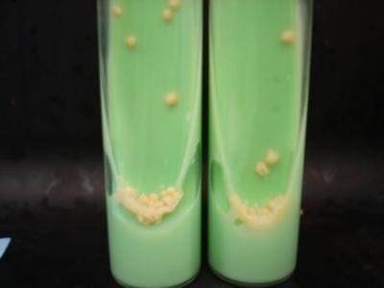
Patient assessments for PWTB on MDR-/RR-TB treatment
Bacteriologic assessment
Clinical assessment
Blood tests
A
Smear and culture for sputum and other body fluids
Monitoring of treatment response
B
Interviews, physical examination and procedures
Monitoring of drug safety
C
Blood count, chemistries, etc.

Slide 15
Clinical assessment for drug safety monitoring
Clinical check | Vital signs (blood pressure, heart rate, respiratory rate, temperature) Interview regarding signs and symptoms, appetite, diarrhea, blurring of vision, etc; signs of fungal infection (from long-term antibiotic use such as the fluoroquinolones and linezolid)

Slide 16
AEs associated with MDR-/RR-TB medicines
Grouping | Drug | Abbreviation | Associated adverse event(s)
A | Levofloxacin OR Moxifloxacin | Lfx Mfx | QT prolongation, tendinitis, tendon rupture
 | Bedaquiline | Bdq | QT prolongation, liver function abnormalities
 | Linezolid | Lzd | Myelosuppression (anemia, thrombocytopenia, neutropenia) Neuropathies (peripheral neuropathy; optic neuritis)
B | Clofazimine | Cfz | Skin discoloration, QT prolongation
 | Cycloserine OR Terizidone | Cs Tzd | Psychiatric effects (psychosis, depression, anxiety), neuropathies, seizures
C | Ethambutol | E | Optic neuritis
 | Delamanid | Dlm | QT prolongation
 | Pyrazinamide | Z | Hepatotoxicity, hyperuricemia
 | Imipenem-cilastatin OR Meropenem | Imp Mpm | Injection site reactions Abdominal pain, nausea, vomiting
 | Amikacin (OR Streptomycin) | Am | Renal failure, hearing loss, electrolyte imbalance
 | Ethionamide OR Prothionamide | Eto Pto | Nausea and vomiting Hypothyroidism (especially together with PAS)
 | P-aminosalicylic acid | PAS | Hypothyroidism (especially together with Pto/Eto )
Heart
Heart / Liver
Blood /Nerves / Eyes
Skin / Heart
Mental health

Slide 17
Adverse events of special interest
Group A & B drugs
1. QT prolongation
2. Liver function abnormalities
3. Myelosuppression
4. Peripheral neuropathy
5. Visual disturbances
6. Psychiatric disorders
Others:
Electrolyte imbalance
Gastrointestinal symptoms
Lactic acidosis
Hypothyroidism
Acute kidney injury
Ototoxicity
Heart
WHO, 2015
Bdq, Mfx, Cfz
Liver
Blood
Lzd
Nerves
Eyes
Mental
health
Cs

Slide 18
Clinical assessments for adverse events of special interest and the associated MDR-TB drugs
Adverse event | Body part/ system | Associated drug/ factor
Peripheral neuropathy | Nerves | Linezolid (Group A)
2. Optic neuritis | Eyes | Linezolid (Group A)
3. Myelosuppression | Blood | Linezolid (Group A)
4. QT prolongation | Heart | Bedaquiline (Group A)
5. Hepatotoxicity | Liver | Bedaquiline (Group A)
6. Psychiatric disorders | Mental health | Cycloserine (Group B)
Pancreatitis | Pancreas | Bedaquiline (Group A) – RARE
Hypokalemia | Potassium | Other factors: vomiting, poor diet
9. Acute kidney injury | Kidneys | Amikacin, Streptomycin (Group C)
10. Hearing impairment | Ears | Amikacin, Streptomycin (Group C) -rare

Slide 19
http://endtb.org/guide
SEVERITY GRADING SCALE:
Once an adverse event is identified, it is helpful to grade its intensity (mild, moderate, severe or life-threatening).
Examples:
Adverse event | Grade 1 Mild | Grade 2 Moderate | Grade 3 Severe | Grade 4 Life-threatening
Vomiting | 1 episode in 24 hours | 2-5 episodes in 24 hours | more than 6 episodes in 24 hours or needing IV fluids | Physiologic consequences requiring hospitalization or administration of nutrition through the veins
Liver enzymes (ALT or SGPT) Increased | Greater than ULN (upper limit of normal) to 3.0 x ULN | Greater than 3.0 to 5.0 x ULN | Greater than 5.0 to 20.0 x ULN | Greater than 20.0 x ULN

Slide 20
1. Peripheral neuropathy
Nerves
Associated with Linezolid
Detection: Physical examination of legs and feet
Normal | Mild ­­­----------­­­­­­­­­­­--------------------------------------------------------------Severe
00 | 01 | 02 | 03 | 04 | 05 | 06 | 07 | 08 | 09 | 10
Scoring
Symptoms Subjective sensory neuropathy score | Right | Left
Pain, aching, or burning in feet, legs | 0 | 0
b. “Pins and needles” in feet, legs present for at least 2 weeks | 3 | 4
c. Numbness (lack of feeling) in feet, legs present for at least 2 weeks | 0 | 0

Slide 21
Severity grading and management of Peripheral neuropathy
Severity Grade | Grade 1 Mild | Grade 2 Moderate | Grade 3 Severe | Grade 4 Life-threatening
Neurosensory alteration | Mild discomfort; no treatment required; and/or BPNS subjective sensory neuropathy score 1-3 on any side. | Moderate discomfort; non-narcotic analgesia required; and/or BPNS subjective sensory neuropathy score 4-6 on any side. | Severe discomfort; or narcotic analgesia required with symptomatic improvement; and/or BPNS subjective sensory neuropathy score 7-10 on any side. | Incapacitating; or not responsive to narcotic analgesia
Action | Stop cycloserine (Cs) and linezolid (Lzd). If symptoms improve, consider restarting these drugs: linezolid at a lower dose 300 mg or 600 mg thrice weekly. If Cs is not essential to the regimen, consider suspending the drug. | Stop Cs and Lzd. If symptoms improve, consider restarting Cs. Do not reintroduce Lzd. Prpovide symptomatic relief. . | Stop Same as Grade 2. | Stop Same as Grade 2.
Non-narcotic analgesia: mild and non-addictive pain relievers
Narcotic analgesia: strong and addictive pain relievers

Slide 22
Symptomatic relief of peripheral neuropathy
Medicines such as acetaminophen or ibuprofen may help decrease or reduce symptoms. Stronger drugs may be needed if without relief.
endTB Clinical Guideline, MSF&PIH, version 3.2

Slide 23
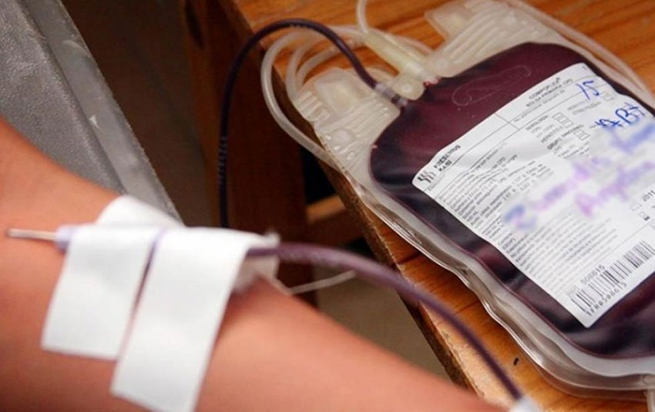
2. Myelosuppression (blood dysfunction)
Blood
Associated with Linezolid
Detection by: Complete blood count (CBC)
Adverse event | Sign | Symptoms
Anemia | Low hemoglobin | Pale appearance Weakness Easily gets tired
Neutropenia | Low white blood cells | Infection
Thrombocytopenia | Low platelets | Bleeding

Slide 24
Severity grading scale of myelosuppression
Severity Grade | Grade 1 Mild | Grade 2 Moderate | Grade 3 Severe | Grade 4 Life-threatening
Hemoglobin | 10.5 - 9.5 g/dL | 9.4 – 8.0 g/dL | 7.9 – 6.5 g/dL | < 6.5 g/dL
Platelets | 99,999-75,000/mm³ | 74,999-50,000/mm³ | 49,999-20,000/mm³ | < 20,000/mm³
While blood cells | <LLN - 3,000/mm³ | <3,000 - 2,000/mm³ | <2,000 - 1,000/mm³ | < 1,000 /mm³
Absolute neutrophil count | 1500 - 1000/mm³ | 999 - 750/mm³ | 749 - 500/mm³ | <500/mm³

Slide 25
Management of myelosuppression
 | Grade 1 Mild | Grade 2 Moderate | Grade 3 Severe | Grade 4 Life-threatening
Action | Monitor carefully, and consider reduction of linezolid (Lzd). | Monitor carefully, do and consider reduction of Lzd dose to 300 mg daily. In case of Grade 2 neutropenia, stop Lzd immediately. In case of Grade 2 anemia, consider Erythropoietin (EPO) . Restart at reduced dose once toxicity has decreased to Grade 1. | Stop Lzd immediately. In case of Grade 3 anemia, consider EPO. Restart at reduced dose once toxicity has decreased to Grade 1. | Stop Lzd immediately. In case of Grade 3 anemia, consider EPO. Restart at reduced dose once toxicity has decreased to Grade 1. .

Slide 26
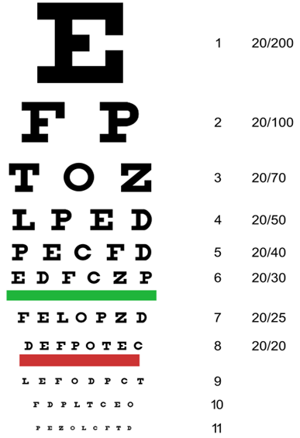
3. Visual disturbances
Eyes
Associated with Linezolid
Visual sharpness (Snellen chart)
Color vision test (Ishihara plates)

Slide 27
Severity grading and management of optic neuritis
Always capture baseline test result to compare test to establish a change in (color) vision or Visual Acuity
NOTE: that due to frequent testing, patients can memorize the plates and respond by memory.
Severity Grade | Grade 1 Mild | Grade 2 Moderate | Grade 3 Severe | Grade 4 Life-threatening
Optic nerve disorder | Asymptomatic; clinical or diagnostic observations only | Limiting vision of the affected eye (20/40 or better) | Limiting vision in the affected eye; visual acuity worse than Limiting vision of the affected eye (20/40 but better than 20/200 | Blindness (20/200 or worse in the affected eye.
Action | Stop Linezolid (Lzd) immediately if there are any suspicions of optic neuritis. Do not restart it. | Stop Lzd immediately if there are any suspicions of optic neuritis. Do not restart it. | Stop Lzd immediately if there are any suspicions of optic neuritis. Do not restart it. | Stop Lzd immediately if there are any suspicions of optic neuritis. Do not restart it.

Slide 28
4. QT prolongation
Heart
Signs and symptoms:
Usually no signs and symptoms
Symptomatic PWTB may complain of
Palpitations, fast heart rate
Dizziness
Chest pain
Loss of consciousness
Detection: ECG (electrocardiogram)
Associated with Bedaquiline

Slide 29
Severity grading and management of QT prolongation
Severity grade | Grade 1 Mild | Grade 2 Moderate | Grade 3 Severe | Grade 4 Life threatening
Prolongation of QT | QTcF 450 – 480 ms (millisecond). | QTcF interval 481– 500 ms. | QTcF > 501 ms on at least two separate ECGs (>30 min apart) without signs/symptoms of arrhythmia (skipped beats) | QTcF >501 ms and life-threatening consequences: Torsade de pointes or polymorphic ventricular tachycardia or signs/ symptoms of serious arrhythmia.
Action | Monitor more closely; at least weekly ECG until QTcF has returned to less than grade 1. Replete electrolytes as necessary. | Monitor more closely; at least weekly ECG until QTcF has returned to less than grade 1. Replete electrolytes as necessary. | Stop the suspected causative drugs.* Hospitalize and replete electrolytes as necessary. *In BPaL: Stop the full BPaL regimen | Stop the suspected causative drugs.* Hospitalize and replete electrolytes as necessary. *In BPaL: Stop the dfull BPaL regimen

Slide 30
5. Hepatotoxicity
Liver
Associated with Bedaquiline
No symptoms, only increased liver enzymes (AST or SGPT, ALT or SGOT)
OR
Signs and symptoms
poor appetite
nausea and vomiting
fatigue
jaundice (yellowing of skin, mucous membranes, and conjunctiva)
darkening of urine
itchiness
abdominal pain

Slide 31
Severity grading and management of hepatitis or elevated liver enzymes
Severity Grade | Grade 1 Mild | Grade 2 Moderate | Grade 3 Severe | Grade 4 Life-threatening
ALT /AST * | >ULN – 3.0 x ULN | >3.0 – 5.0 x ULN | >5.0 – 20.0 x ULN | >20.0 x ULN
Bilirubin | >ULN - 1.5 x ULN | >1.5 - 3.0 x ULN | >3.0 - 10.0 x ULN | >10.0 x ULN
Action | Continue treatment regimen. Patients should be followed until resolution (return to baseline) or stabilization of AST/ALT elevation. | Continue treatment regimen. Patients should be followed until resolution (return to baseline) or stabilization of AST/ALT elevation. | Stop all drugs including anti-TB drugs; measure liver function tests (LFTs) weekly. Treatment may be reintroduced after toxicity is resolved. *In BPaL: Stop the full BPaL regimen | Stop all drugs including anti-TB drugs; measure liver function tests (LFTs) weekly. Treatment may be reintroduced after toxicity is resolved. *In BPaL: Stop the full BPaL regimen
*Liver enzymes ULN- upper limit of normal

Slide 32
Management of hepatitis or elevated liver enzymes
Consider medical conditions which may cause elevated liver enzymes, such as viral hepatitis, alcohol, HIV coinfection
Consider present medicines: anti-TB or non-anti-TB medicines
Consider interaction among the drugs taken by the PWTB

Slide 33
6. Severity grading of psychiatric disorders
Adverse event Definition | Grade 1 Mild | Grade 2 Moderate | Grade 3 Severe | Grade 4 Life-threatening
Anxiety A disorder characterized by apprehension of danger and dread accompanied by restlessness, tension, tachycardia, and dyspnea unattached to a clearly identifiable stimulus. | Mild symptoms; intervention not indicated; and/or Hamilton Anxiety Rating Scale score 1-17 | Moderate symptoms; limiting instrumental ADL; and/or Hamilton Anxiety Rating Scale score 18-24 | Severe symptoms; limiting self-care ADL; hospitalization not indicated; and/or Hamilton Anxiety Rating Scale score 25-30 | Life-threatening; Hamilton Anxiety Rating Scale score >30; and/or hospitalization indicated
Depression A disorder characterized by melancholic feelings of grief or unhappiness. | Mild depressive symptoms; and/or PHQ9 depression score 1-9. | Moderate depressive symptoms; limiting instrumental ADL; and/or PHQ9 depression score 10-14. | Severe depressive symptoms; limiting self-care ADL; hospitalization not indicated; and/or PHQ9 depression score 15-19. | Life-threatening consequences, threats of harm to self or others; PHQ9 depression score 20-27; and/or hospitalization indicated

Slide 34
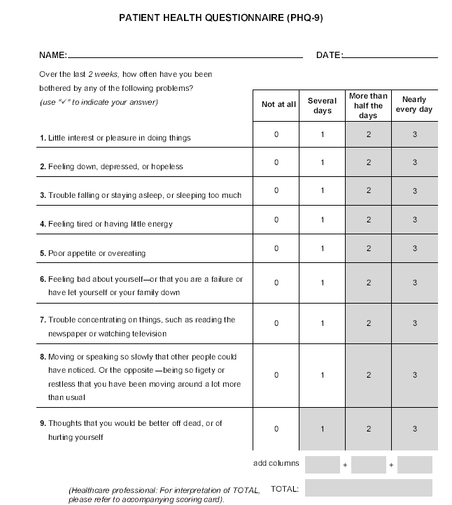
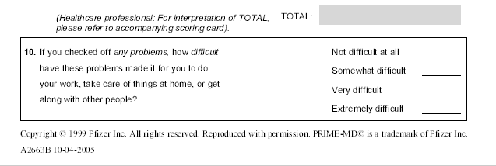
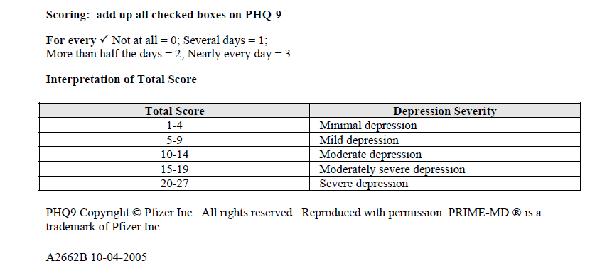
Depression questionnaire (PHQ-9) – (2) Psychometric Health Questionnaire

Slide 35
Managing depression
1. Avoidance of medicines causing or worsening depression
2. Does adjustment
3. Assessment/ addressing underlying emotional and socio-economic issues (do not underestimate)
4. Assessment for suicidal ideation; for coexisting substance abuse and refer.
5. Individual/group counselling lay counsellors and TB survivors.
6. Medical therapy, e.g., anti-depressant

Slide 36
Summary
Patient monitoring for treatment response and drug safety are crucial especially in the period of new medicines, regimens and operational research
AE monitoring should be aligned to the risks carried by the drugs used,
e.g., ECG, visual acuity test, audiometry for amikacin
Anti-TB medicines are not the only culprits in AEs
Awareness and capacity building on identification and management (for both PWTB and health provider)

Slide 37
Thank you very much!

