Slide 1
Patient monitoring for treatment response
LIFT-TB Community Engagement Project Training of Trainors
23-25 August 2021
Manila, Philippines
Mamel Quelapio. MD
Consultant, TB Alliance
In collaboration with TBPeople Philippines

Slide 2
Outline
Patient monitoring
Part 1: Monitoring treatment response
Part 2: Monitoring drug safety

Slide 3
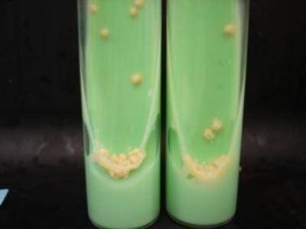
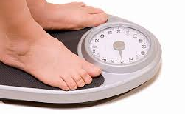
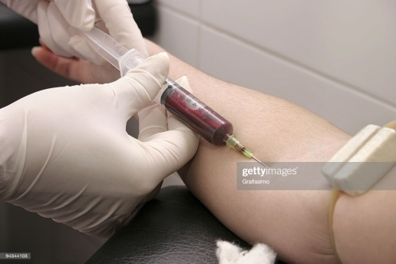
Patient assessments for PWTB on MDR-/RR-TB treatment
Bacteriologic assessment
Clinical assessment
Blood tests
A
Smear and culture for sputum and other body fluids
Monitoring of treatment response
B
Interviews, physical examination and procedures
Monitoring of drug safety
C
Blood count, chemistries, etc.

Slide 4
Clinical assessment for treatment response monitoring
A
Clinical check | Vital signs (blood pressure, heart rate, respiratory rate, temperature) Interview regarding signs and symptoms, appetite, etc. Physical examination: signs of respiratory distress or difficulty of breathing, lung findings from stethoscope examination, etc.
Weight | Weight gain is a sign of improvement; weight loss of 1-2 pounds per week, if unexplained, can mean worsening. For example, if a PWTB is on a diet for intentional weight loss, this may not be a concern.
Chest X-Ray | Improved chest x-ray is a sign of the patient getting better.
Treatment outcome assessment | Determined at the end of treatment, and after treatment (to know if cure is maintained and the TB bacteria have not become positive again).

Slide 5
Bacteriologic assessment for treatment response monitoring
B
Gene Xpert | Done only once (pre-treatment) to determine the presence of Mycobacterium TB and whether Rifampicin is still effective. Not used to monitor treatment response
Sputum smear microscopy (DSSM) and TB culture | Both tests are used to detect the presence or absence of TB bacteria. A change from positive to negative bacteria is a sign of improvement.
Sputum drug susceptibility testing (DST) | Test performed on a positive culture to see which drug(s) are effective against the TB bacteria.
Other sample (not from the lungs) - DSSM and TB culture | If TB is not in the lungs, specimen from the affected site of the body, for example, lymph node, is examined for the presence or absence of bacteria.

Slide 6
Schedule of patient assessments for PWTB on MDR-TB treatment
Baseline or pre-treatment period
In other MDR-TB regimens: 30 days before and within 7 days after start of treatment
BPaL regimen: within 14 days before start of treatment
Twice monthly during 1st month (for BPaL only)
Monthly
End of treatment – treatment outcome
6 and 12 months after treatment

Slide 7
WHO-recommended MDR/RR-TB regimens
Shorter all-oral bedaquiline-containing regimen
Longer MDR-TB regimens
Individualized regimen
3. BPaL regimen
1
2
3

Slide 8
Assessments for Standardized shorter all-oral regimen (SSOR) (Philippine NTP)
Schedule of assessments
Baseline or pre-treatment period
30 days before and within 7 days after start of treatment
Monthly till end of treatment
6 and 12 months after treatment
Pocket guide, NTP, Philippines

Slide 9
Assessments for Longer regimens (Philippine NTP)
Schedule of assessments
Same as that of SSOR
Pocket guide, NTP, Philippines

Slide 10
 | Baseline | 2 weeks | Monthly | End of treatment | 6- and 12-months after treatment completion
CLINICAL EVALUATION
Clinical assessment*¹ | X | X | X | X | X
Psychosocial assessment*² | X | X | X | X | X
Performance status³ | X
Weight / BMI | X | X | X | X | X
Peripheral neuropathy screen⁴ | X | X | X | X | X
Chest X-Ray | X |  | X-If no response to treatment | X | X
ECG | X | X | X | X | X-If indicated
Visual acuity and colour discrimination screen | X | X | X | X | X
Assessment and follow-up of AEs | X(X) | X(X) | X(X) | X(X) | X(X)
Treatment outcome assessment |  |  |  | X | X
BACTERIOLOGIC EVALUATION
Gene Xpert | X
Sputum smear | X |  | X | X | X
Sputum culture⁵ | X(X) |  | X (X) | X(X) | X(X)
Sputum drug susceptibility testing ⁶ | X (X) |  | X-If culture positive⁷
Other sample smear | X |  | X-If no response to treatment
Other sample culture | X(X) |  | X-If no response to treatment
Other sample drug susceptibility testing | X |  | X-If culture positive⁷
LABORATORY EVALUATION
Full blood count | X | X | X | X | X-if indicated
Liver function tests (AST, ALT, bilirubin) | X | X | X | X | X-if indicated
Thyroid stimulating hormone (TSH) | X |  | X - if indicated
Serum electrolytes (Na, K, Ca, Mg) | X |  | X | X | X-if indicated
Serum amylase |  |  | X - if indicated
Kidney function tests (Urea, Creatinine) | X |  | X - if indicated
BSL (fasting or random)⁸ | X
HIV / HBV / HCV tests | X
Pregnancy test⁹ | X |  | X - if indicated
A
Assessments for the BPaL regimen: Baseline (pre-treatment), during and post-treatment
B
C
BPaL protocol

