Slide 1
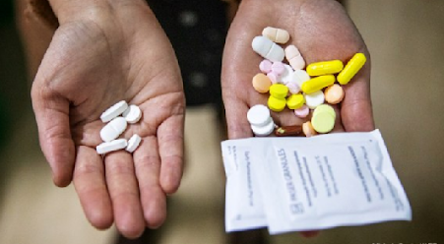
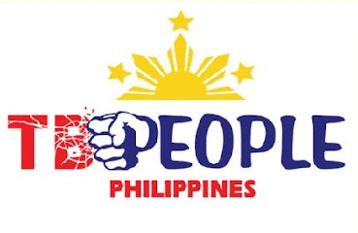
The BPaL regimen
LIFT-TB Community Engagement Project Training of Trainors
23-25 August 2021
Manila, Philippines
Mamel Quelapio. MD
Consultant, TB Alliance
In collaboration with TBPeople Philippines

Slide 2
Regimens for MDR/RR-TB
C
Shorter all-oral Bedaquiline-containing regimen
Longer MDR-TB regimens
3. BPaL regimen
1
2
3

Slide 3
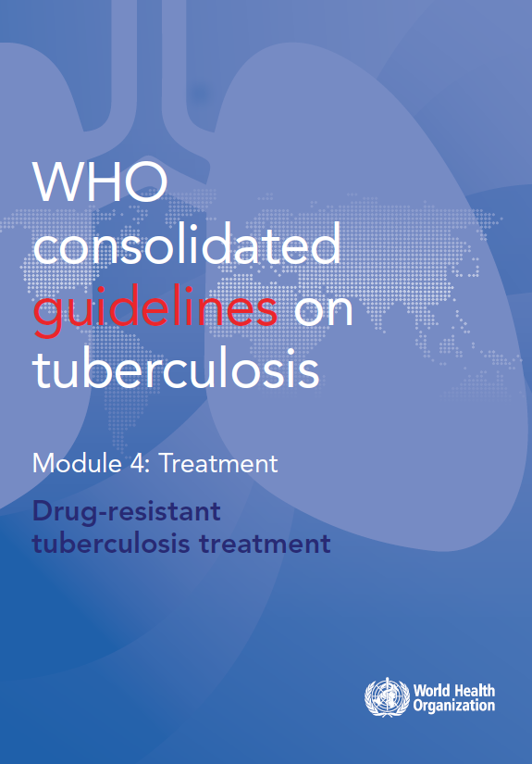
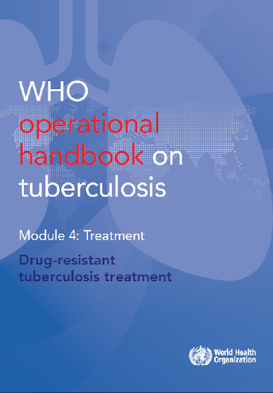
BPaL regimen under operational research
3
B for Bdq- Bedaquiline Pa- Pretomanid L for Lzd – Linezolid

Slide 4

Operational research
A form of study using research techniques to gather evidence that supports the effective, sustained and firm adoption of interventions by decision-makers within a health system to improve health or patient outcomes.
It also addresses the knowledge gap between what works well in a controlled environment (efficacy) and what works in the real world (effectiveness) and current practices to provide the greatest benefits in disease control.

Slide 5

BPaL regimen
1
3
Duration
Composition* *Standardized or fixed regimen
6 months extendable to 9 months, if still culture positive on month 4
6 Bdq – Pa - Lzd
B for Bdq- Bedaquiline Pa- Pretomanid L for Lzd – Linezolid
Notes:
Fixed regimen

Slide 6
BPaL regimen
3
Who qualify for the regimen? Eligibility
  Person with MDR/RRTB with:
    Fq* ineffectiveness (pre-XDR)
    Fq* still effective but cannot tolerate the current MDR treatment because of side effects, or
    Fq* still effective but with no response to current MDR treatment, meaning, the sputum is persistently positive for TB bacteria or the symptoms are not getting better
  With no previous use or exposure to Bdq and Lzd for more than 2 weeks**
6 Bdq-Pa-Lzd
*Fq (Fluoroquinolone): either Levofloxacin, Moxifloxacin
**The BPaL regimen is based on WHO recommendation, which is, in turn, based on evidence from Nix-TB study. However, some countries are now considering 4 weeks instead of 2 weeks to be more practical.
Notes:
Fixed regimen

Slide 7
BPaL regimen
3
3
Who qualify for the regimen?
  14 years old and above
  Weighs 35 kg and above
  Willing to provide informed consent to be enrolled under Operational Research (OR)and to adhere to the follow-up schedule
6 Bdq-Pa-Lzd
B/Bdq- Bedaquiline Pa- Pretomanid L/Lzd – Linezolid
Notes:
Fixed regimen

Slide 8
1
BPaL regimen
3
Who do not qualify for the regimen?
Pregnant; unwilling to use contraceptive
Breastfeeding
Severe extrapulmonary TB
Evidence that the component drugs (Bdq-Pa-Lzd) are ineffective
Known allergy to any of the component drugs (Bdq-Pa-Lzd)
6 Bdq-Pa-Lzd
B/Bdq- Bedaquiline Pa- Pretomanid L/Lzd – Linezolid
Notes:
Fixed regimen

Slide 9
BPaL regimen: dosage
6 Bdq – Pa - Lzd
Medicine | Preparation | Dose*
Bedaquiline (Bdq) | 100 mg /tab | 400 mg daily for 2 weeks, then 200 mg thrice weekly for 24 weeks
Pretomanid (Pa) | 200 mg /tab | 200 mg daily
Linezolid (Lzd) | 600 mg/tab | 1200 mg daily
*Regardless of the weight
B/Bdq- Bedaquiline Pa- Pretomanid L/Lzd – Linezolid

Slide 10
BPaL regimen: pill burden
6 Bdq – Pa - Lzd
No. of medicines | 3 all throughout: 2 group A and 1 new drug
Daily pill burden
- 1st 2 weeks | 7 tabs (4 Bdq, 1 Pa, 2 Lzd)
- Remaining 24 weeks
3X a week | 5 tabs (2 Bdq, 1 Pa, 2 Lzd)
4X a week | 3 tabs (1 Pa, 2 Lzd)
Maximum no. of tabs per course | 746 tabs
B/Bdq- Bedaquiline Pa- Pretomanid L/Lzd – Linezolid

Slide 11

BPaL regimen
3
Who qualify for the regimen? Eligibility
  Person with MDR/RRTB with:
    Fq* ineffectiveness (pre-XDR)
    Fq* still effective but cannot tolerate the current MDR treatment because of side effects, or
    Fq* still effective but with no response to current MDR treatment, meaning, the sputum is persistently positive for TB bacteria or the symptoms are not getting better
  With no previous use or exposure to Bdq and Lzd for more than 4 weeks**
6 Bdq-Pa-Lzd
*Fq (Fluoroquinolone): either Levofloxacin, Moxifloxacin
**The BPaL regimen is based on WHO recommendation, which is, in turn, based on evidence from Nix-TB study. However, some countries are now considering 4 weeks instead of 2 weeks to be more practical.
Notes:
Fixed regimen

Slide 12
3
BPaL regimen
Who qualify for the regimen?
  18 years old and above
  15-17 years with the approval of TB Medical Advisory Committee (TB MAC)
  Weighs 35 kg and above
  Willing to provide informed consent to be enrolled under Operational Research (OR)and to adhere to the follow-up schedule
6 Bdq-Pa-Lzd
B/Bdq- Bedaquiline Pa- Pretomanid L/Lzd – Linezolid
Notes:
Fixed regimen

Slide 13
BPaL regimen
WHO Recommendation
Philippine Setting
Eligibility
Age: 15-17 years old as long as with TB MAC approval
Exposure to BPaL component agents (bedaquiline, delamanid and linezolid) not more than 4 weeks (instead of 2 weeks)
BPaL regimen
BPaL regimen
6 Bdq-Pa-Lzd
6 Bdq-Pa-Lzd
Duration: 6 extendable to 9 months
Duration: 6 extendable to 9 months
Department of Health – National TB Control Program
Notes:
Not to be given to a patient with any of the following:
Disseminated/extensive TB or severe/intractable extrapulmonary (EP) TB (e.g. TB Meningitis, Bone/Joint TB)
Confirmed resistance to fluoroquinolone (Moxifloxacin/Levofloxacin)
Exposure to Moxifloxacin/Levofloxacin, Bedaquiline, Clofazimine, Prothionamide for >1 month
Risk of toxicity or intolerance to any drugs in SSOR as manifested by:
History of heart disease (heart failure, myocardial infarction, cardiac conduction abnormality, arrythmia)
QTcF >500 ms
History of chronic active hepatitis (AST/ALT >5 times elevated)
History of chronic renal insufficiency (Creatinine Clearance <20 mL/min)

Slide 14
Summary of MDR-TB Regimens
Shorter all-oral Bedaquiline-containing regimen
Longer MDR-TB regimens
3. BPaL regimen
1
2
3

Slide 15
Comparison of the MDR-TB regimens
Duration
Composition
Implementation condition
Eligibiltiy (which patients qualify)
Age group
Special conditions
No. of medicines
Daily pill burden
Total no. of tablets
Cost

Slide 16
Comparison of the three MDR-TB regimens
 | Shorter all-oral regimen | Longer regimens | BPaL regimen
1. Duration | 9* months *extendable to 11 months | 18* months *extendable to 20 months | 6 months *extendable to 9 months
2. Composition
2
1
3
4-6 Bdq-Lfx-Cfz-Z-E-Hh-Eto /
5 Lfx-Cfz-Z-E
6Bdq-Lzd-Lfx-Cfz /
12-14Lzd-Lfx-Cfz
6 Bdq-Pa-Lzd
6Bdq-Lzd-Cfz-Cs-Dlm/
12-14Lzd-Cfz-Cs
Individualized regimen
BB/dq- bedaquiline Lfx- levofloxacin Cfz-clofazimine Z- pyrazinamide E-ethambutol Hh-high dose isoniazid Eto- ethionamide L/Lzd – linezolid Pa - pretomanid

Slide 17
Comparison of the three MDR-TB regimens
 | Shorter all-oral regimen | Longer regimens | BPaL regimen
3. Implementation condition | Program conditions Operational research if modified | Program conditions | Operational research
4. Eligibility Fq effectiveness Other factors | Fq is still effective Has not used second-line drugs more than 1 month (unless proven effective) | FQ is either effective or ineffective | Fq is ineffective, or Treatment-intolerant Treatment non-responsive
1
2
3

Slide 18
Comparison of the three MDR-TB regimens
 | Shorter all- oral regimen | Longer regimens | BPaL regimen
5. Age group | 6 years old and above | 6 years old and above | 14 years old and above
6. Special conditions
Pregnancy | Not allowed | Allowed selected agents | Not allowed
Extensive TB | Not allowed | Allowed | Allowed
Severe EPTB | Not allowed | Allowed selected agents | Not allowed
HIV | Allowed | Allowed | Allowed
1
2
3

Slide 19
Comparison of the three MDR-TB regimens
 | Shorter all- oral regimen | Longer regimens | BPaL regimen
7. No. of medicines | 7 during 1st 4-6 months 4 thereafter | 4 during 1st 6 months 3 thereafter | 3 all throughout
8. No. of tablets/day | For 50 kg PWTB* 14-18 tabs 1st 6 mos 9 tabs thereafter | For 50 kg PWTB* 6-8 tabs 1st 6 mos 4 tabs thereafter | Regardless of weight* 7 tabs for 2 weeks 3-5 tables for 24 weeks
9. Total no. of pills | 2,928 (9 months) | 2,216 (18 months) | 746 tabs (6 months)
1
2
3

Slide 20
No. of pills daily for the BPaL regimen
No. of pills daily for the longer (individualized) regimen

Slide 21



Treatment Regimen
Cost (in PhP)
10. Cost of MDR/RR-TB Treatment
SSOR
38,746.16
SLOR FQ-S
68,748.08
SLOR FQ-R
181,604.95
ITR
598,406.04
BPaL
43,350*
*Global Drug Facility
  All expenses under the TB program are free of charge!
Department of Health – National TB Control Program
Notes:
Treatment is free

Slide 22
Thank you very much!
The development of these training materials intended for TB advocates is through the support of TB Alliance, a not-for-profit organization dedicated to the discovery, development and delivery of better, faster-acting and affordable tuberculosis drugs available to those in need.

