Slide 1
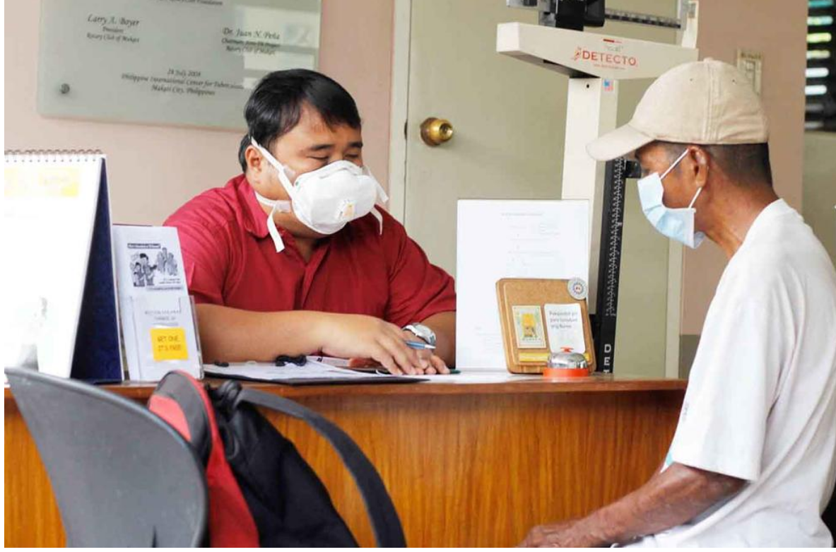
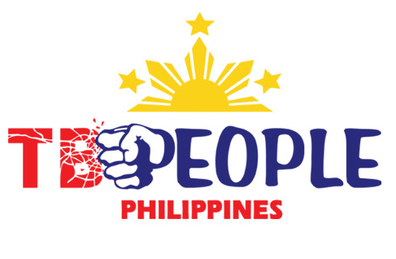
Scale (Magnitude) of the TB problem
LIFT-TB Community Engagement Project Training of Trainers for TBPeople Philippines
Mamel Quelapio. MD
Consultant, TB Alliance
In collaboration with TBPeople Philippines

Slide 2
Outline
Scale (Magnitude) of the TB problem
  Global
  Regional (Western Pacific Region)
  Country (Philippines)

Slide 3
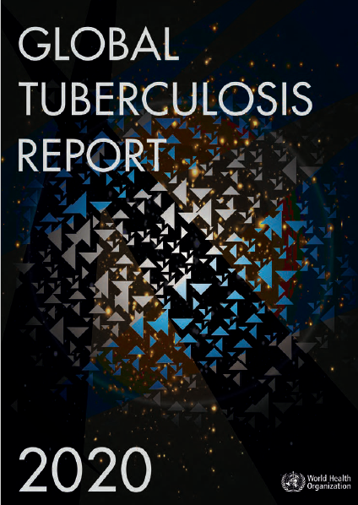
Global, regional and country, 2019
Magnitude (Scale) of the TB problem
 | Global
Estimated TB | 10 million
Notified (Reported) | 7.1 million
Treatment success (new) | 85%
Regional Western Pacific
1.8 million
1.4 million
89%
Country Philippines
599,000
419,100
83%
Gap:
30%
Gap:
23%
Gap:
30%
https://www.who.int/teams/global-tuberculosis-programme/tb-reports/global-tuberculosis-report-2020
Missing cases remain the major problem !

Slide 4
Definition of terms
Estimated TB and MDR/RR-TB: Number of persons that developed TB and MDR/RR-TB in a year
Notified (Reported) TB and MDR/RR-TB: Number of persons reported to have MDR/RR-TB detected by drug susceptibility testing (DST) or were laboratory–confirmed to have MDR/RR-TB in a year
Enrolled MDR/RR-TB: Number of persons with TB and MDR/RR-TB started on MDR-TB treatment in a year
Average count of treatment success in a year in persons with TB and MDR/RR-TB and XDR-TB

Slide 5
Globally in 2019
Estimated
- TB 10 million
- MDR/RR-TB 465’000
Notified (Reported)
-TB 7,1 million
- MDR/RR-TB 206’030 (12’350 XDR)
Gap: 30%
Gap: 53%
https://www.who.int/teams/global-tuberculosis-programme/tb-reports/global-tuberculosis-report-2020
Enrolled MDR/RR-TB - 177’099 (12’960 XDR)
Gap: 59%
Global average of treatment success
TB (new): 85%
MDR/RR-TB: 57%; XDR-TB: 39% (2017)

Slide 6
Western Pacific Region in 2019
Estimated
- TB 1.8 million
- MDR/RR-TB 101’000
Notified (Reported)
- TB 1.4 million
- MDR/RR-TB - 31’099 (517 XDR)
Gap: 23%
Gap: 69%
https://www.who.int/teams/global-tuberculosis-programme/tb-reports/global-tuberculosis-report-2020
Enrolled MDR/RR-TB 15,699 (94 XDR)
Gap: 84%
Regional average of treatment success
TB (new): 89%
MDR/RR-TB: 60%; XDR-TB: 60% (2017)

Slide 7
The Philippines in 2019
Estimated
- TB 599,000
- MDR/RR-TB 21’000
Notified(Reported)
TB 419,100
MDR/RR-TB 7’492 (81 XDR)
Gap: 30%
Gap: 64%
Enrolled MDR/RR-TB 5’421 (18 XDR)
https://www.who.int/teams/global-tuberculosis-programme/tb-reports/global-tuberculosis-report-2020
Gap: 74%
National average of treatment success :
TB (new): 83%
MDR/RR-TB: 58%; XDR-TB: 61% (2017)

Slide 8
Global, regional and country, 2019
Magnitude (Scale) of the DR-TB problem
 | Global | Regional Western Pacific | Country Philippines
Estimated MDR/RR-TB | 465,000 | 101,000 | 21,000
Notified (Reported) MDR-TB XDR-TB | 206,030 12,350 | 31,099 517 | 7,492 81
Enrolled MDR-TB XDR-TB | 177,099 12,960 | 15,699 94 | 5,421 18
Treatment success MDR-TB XDR-TB | 57% 39% | 60% 60% | 58% 61%
Gap:
47%
Gap:
31%
Gap:
36%
https://www.who.int/teams/global-tuberculosis-programme/tb-reports/global-tuberculosis-report-2020
Gap:
41%
Gap:
16%
Gap:
26%
The gaps in DR-TB notification, enrolment and treatment success are huge!

Slide 9
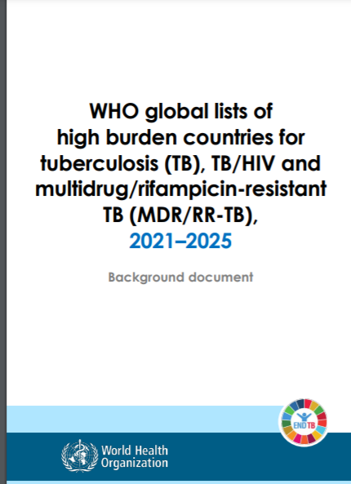
High burden countries (HBC)
The new list 2021-2025
Countries in the Western Pacific Region with high MDR-TB burden:
China
Mongolia
Papua New Guinea
Philippines
Vietnam

Slide 10
Thank you very much!

