Slide 1
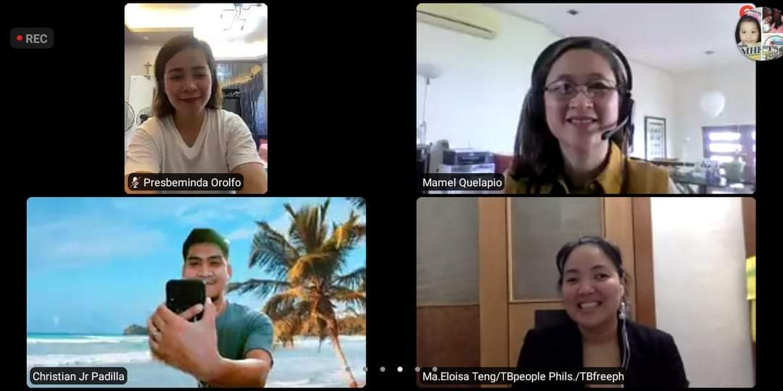
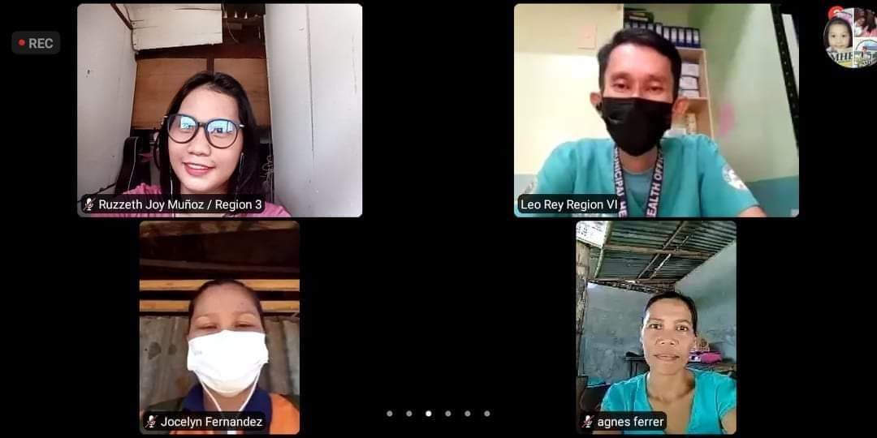
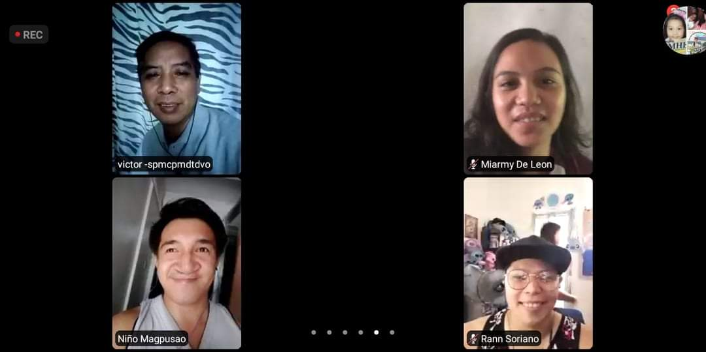
Development of training materials for drug-resistant TB
Series of interactive workshops with TBPeople Philippines
18 Jun - 9 July 2021
Maria Imelda (Mamel) Quelapio. MD
Consultant, TB Alliance

Slide 2
PROCESS OF MATERIAL DEVELOPMENT
Finalized presentation for advocates
Review by TBA and NTP
Feedback from TB People
TRAINING OF TRAINERS
Presentation (interactive)

Slide 3
Topics most relevant - for advocates - for people with TB - for family - for the community to know and understand
TOPICS (DR-TB)
BACKGROUND
DIAGNOSIS
TREATMENT
Definitions
Regimens
BPaL Operational research
PATIENT MONITORING
For treatment response
For drug safety
TB People, TB Alliance

Slide 4
TIMELINES OF MATERIAL DEVELOPMENT
TOPIC | Presentation | Feedback from TBP
TREATMENT
Definitions | Jun 18 | Jun 20
Regimens | Jun 22 | Jun 24
BPaL Operational research | Jun 24 | Jun 26
PATIENT MONITORING
For treatment response | Jun 28 | Jun 30
For drug safety | June 28, July 1, 5 | Jun 30, Jul 3, 7
BACKGROUND | July 6 | Jul 8
DIAGNOSIS | July 9 | Jul 11
Review by the NTP and TB Alliance
Finalization
TRAINING OF TRAINERS | 23-25 Aug 2021

Slide 5
BACKGROUND Main references:
B. DEVELOPMENT OF LITERACY MATERIALS
2021
2020
2020

Slide 6
Core features of materials
Simplified
Accurate
Aligned with WHO, NTP policies and guidelines
Consistent with TB Alliance principles
Patient-/people-centered

Slide 7
Compassionate language in TB
PREFERRED TERM | INSTEAD OF
Person with TB (PWTB) | Patient; client; “case”
Person with TB symptoms Person to be evaluated for TB Presumptive TB | TB suspect
Adherence | Compliance
Person lost to follow-up | Defaulter
TB prevention and care | TB control

Slide 8
Overall learning objectives of the training materials
At the end of the Training of Trainers, the participant is able to:
Understand and be able to recall the major aspects of drug-resistant TB based on WHO and country guidelines through simplified information, such as key definitions, scale of the problem, diagnosis, treatment and patient monitoring
2. Use the information he learns in the context of his task as an advocate for persons with TB (PWTB)
3. Use the information in developing literacy materials with focused messages for PWTB, their family members and community advocates

Slide 9
Thank you very much!
The development of these training materials intended for TB advocates is through the support of TB Alliance, a not-for-profit organization dedicated to the discovery, development and delivery of better, faster-acting and affordable tuberculosis drugs available to those in need.

